Slide 1
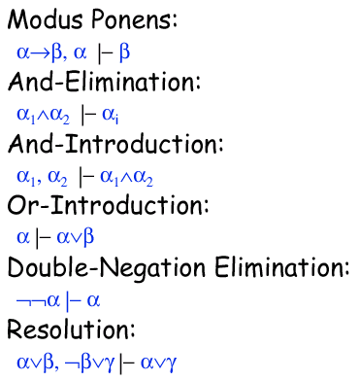
Inference Rules
Some patterns of reasoning are so common that instead of creating a truth table each time we see them, we can just establish their truth once, then reuse the pattern in any situation.

Slide 2
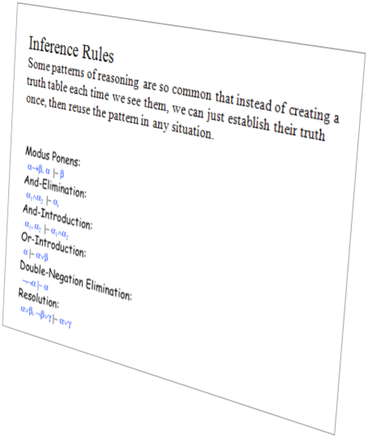
Last time we saw some inference rules…
Rules of inference are syntactical transform rules which one can use to take a fact(s) and generate new fact(s).
The set shown below is not the full set. For example I did not include some obvious ones:
  Commutative: A ∨ B ⇒ B ∨ A
  Associative: (A ∨ B) ∨ C ⇒ A ∨ (B ∨ C)
And I did not include some rare, unintuitive rules
  *Modus tollens: A ⇒ B, ¬B |- ¬A
The set we have is complete, we could use them to derive all others.
* A ⇒ B, ¬B |- ¬A
If I am a dog, I have a tail
I do not have a tail
Therefore, it is not true I am a dog

Slide 3
Knowledge Base
TELL A John is over 18 , as it happens we know John is 50

Slide 4
Knowledge Base
A
¬B
TELL ¬B
B means Susan is over 18 , as it happens we know Susan is 7

Slide 5
Knowledge Base
A
¬B
C ∨ D
TELL C ∨ D John is married OR John is happy

Slide 6
Knowledge Base
A
¬B
C ∨ D
A ∧ F
¬B ∧ C ⇒ F

Slide 7
Knowledge Base
A
¬B
C ∨ D
A ∧ F
¬B ∧ C ⇒ F
Suppose someone ASKs A
In other words, is it the case that …
Knowledge Base |- A
Since A appears in out KB, then yes.

Slide 8
Knowledge Base
A
¬B
C ∨ D
A ∧ F
¬B ∧ C ⇒ F
Suppose someone ASKs F
In other words, is it the case that …
Knowledge Base |- F
This time F does not appear, by itself, in the KB.
There are two ways we might be able to do this, first truth tables..

Slide 9
Knowledge Base
A
¬B
C ∨ D
A ∧ F
¬B ∧ C ⇒ F
A ∧ ¬B
Suppose someone ASKs F
In other words, is it the case that …
Knowledge Base |- F
The second way is expanding our Knowledge Base until it includes the literal F. Lets try AND-Introduction …did not help

Slide 10
Knowledge Base
A
¬B
C ∨ D
A ∧ F
¬B ∧ C ⇒ F
A ∧ ¬B
A
F
Suppose someone ASKs F
In other words, is it the case that …
Knowledge Base |- F
That did not help, lets try AND Elimination That worked

Slide 11
Knowledge Base
A
¬B
C ∨ D
A ∧ F
¬B ∧ C ⇒ F
A ∧ ¬B
A
F
Suppose someone ASKs T
Since T does not appear in the KB, it is definitely not entailed by it. However, there may be questions that we can ASK, that do refer to propositional symbols in our KB, but the KB does not entail them.

Slide 12
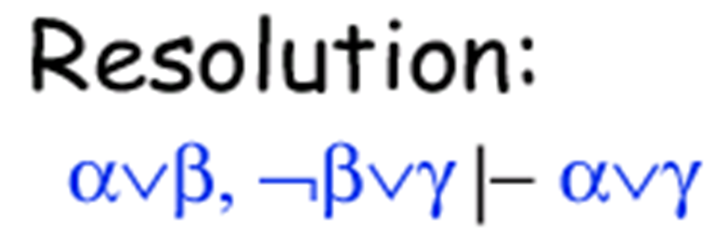
Suppose you know that you are going to fail or pass CS 170. Further, since this is the only class you need to graduate, you know that you are going to either not pass the class or graduate on time.
Then you can derive the fact that you will either not pass or you graduate on time.
Fail or Pass, not Pass or GraduateOnTime
Therefore Fail or GraduateOnTime
F ∨ P, ¬P ∨ G
F ∨ G
F Fail
P Pass
G Graduate on time

Slide 13
Limitations of Propositional Logic
Hard to identify individuals (terms). E.g., Mary, John, 17, Canada. (Propositional Logic is good for facts, not individuals)
Can't directly talk about properties of individuals or relations between individuals. E.g., how to represent the fact that John is tall?
We could try a variable JohnIsTall, but suppose we then want to encode a rule that tall people are good at basketball, TallPeople ⇒ GoodAtBasketball Given a knowledge base that consists of
        JohnIsTall
        TallPeople ⇒ GoodAtBasketball
We have no way to conclude that John is good at basketball!
Generalizations, patterns, regularities can't easily be represented. E.g., all triangles have 3 sides

Slide 14
Lets expand our view of the world. Before the world consisted of facts (Propositional Logic), now we consider the world of First Order Logic (FOL), which consists of
Terms (objects)
People, Numbers, Cars, Bicycles, Books, Events, Places...
Functions (Statements that return Terms)
MotherOf, DivisorOF, CountryOfOriginOf
Predicates (Statements that return True or False)
isMale, isPrime, isAmerican, isHardback, isReligious, isNatoMember...
Connectives
Quantifiers
∧, ∨ , ¬ , ⇒, ⇔
∃ ∀

Slide 15
We normally write functions as somethingOf
We normally write predicates as isSomething
However, these are not enforced, and not consistent from book to book.
Sometimes these standards produce weird or ambiguous function or predicate names, so they are avoided.
For example:
  isCat(P) seem natural for a predicate for felineness.
  But isTailOwner(P) seems less natural than hasTail(P)
  And isLessThan does not scan as well as just lessThan(X)
Functions (Statements that return Terms)
MotherOf, DivisorOF, CountryOfOriginOf
Predicates (Statements that return True or False)
isMale, isPrime, isAmerican, isHardback, isReligious, isNatoMember...

Slide 16
Terms (A term is an expression that refers to an object).
Either
A symbol
A function application
Symbols can be constants: John, Mary, 17, 56
or variables: F_name, L_name, X, Y
Function applications are usually written as SomethingOf
        MotherOf(John)
        AgeOf(Mary)
        EyeColorOf(MotherOf(John))

Slide 17
There is an important difference between Predicates and Functions
Predicates
isMale, isPrime, isReligious, isCapitalCity
(mapping from terms to truth values)
isMale(Joe), isMale(Sue), isPrime(10), isPrime(7)
TRUE FALSE FALSE TRUE
Functions
MotherOf, DivisorOF, CountryOfOriginOf
(mapping from things to things)
MotherOf(John), CountryOfOriginOf(Eamonn)
Mary Ireland

Slide 18
How to interpret Predicates
isBrother(Harpo, Groucho)
It is the case that Harpo is the brother of Groucho
isMother(Minnie, Groucho)
It is the case that Minnie is the mother of Zeppo
isCountryOfOrigin(Jordan, Ireland)
It is the case that Jordan is the Country of Origin of Ireland
Otherwise are we claiming Mike Ireland is from Jordan or Michael Jordan is from Ireland?

Slide 19
Note that the predicate... isBrother(Harpo, Groucho)
..does not automatically imply isBrother(Groucho, Harpo)
Just as... isMother(Minnie, Groucho)
...clearly does not imply isMother(Groucho, Minnie)
If we want to encode the fact that the bother relation is symmetric, we must do so explicitly...
isBrother(x, y) ⇒ isBrother(y, x)
This would only be true in a universe that has only males! (because y could be a female). This might be a universe of interest. For example our KB might be about Popes or Presidents

Slide 20
Atomic Sentences (An atomic sentence is a predicate with its “arguments”, it has a True/False value).
  isPrime(12)
  isPrime(x)
  isBrother(Harpo, Groucho)
  isBrother(Harpo, person1)
Atomic sentences can have complex terms.
  isPrime( SquareRootOf(25) )
  isBrother(Harpo, YoungestSonOf( MinnieMarx ) )
MinnieMarx is a constant term. If we apply the function YoungestSonOf to MinnieMarx we get Chico, who was a bother of Harpo, so the predicate brother(Harpo, YoungestSonOf( MinnieMarx ) ) is TRUE.

Slide 21
Complex Sentences (Atomic sentence with logical connectives).
  isPrime(x) ∨ isDivisibleByTwo(x)
  isBrother(Harpo, Groucho) ⇒ isBrother(Groucho, Harpo)
¬isBrother(Harpo, Eamonn)

Slide 22
Since we now have a way to represent objects, we need a way to represent properties for classes of objects.
Suppose I want to represent the fact that all Irishmen are European. We what we have learned to this point I could represent that fact like this…
  isIrish(Eamonn) ⇒ isEuropean(Eamonn) ∧
  isIrish(LiamNeeson) ⇒ isEuropean(LiamNeeson ∧
  isIrish(Bono) ⇒ isEuropean(Bono) ∧
  isIrish(PierceBrosnan) ⇒ isEuropean(PierceBrosnan) ∧ ….
However FOL allows a shortcut, the Universal qualifier ∀
    ∀x isIrish(x) ⇒ isEuropean(x)
Read as: For all x, isIrish(x) implies isEuropean(x)

Slide 23
FOL allow us to make statements about the existence of objects.
Suppose I want to represent the fact that there are non-Irish Europeans. I could do this by stating
  isEuropean(bob) ∧ ¬isIrish(bob) ∨
  isEuropean(joe) ∧ ¬isIrish(joe) ∨
  isEuropean(tom) ∧ ¬isIrish(tom) ∨….
However FOL allows a shortcut, the Existential qualifier ∃
    ∃x isEuropean(x) ∧ ¬isIrish(x)
Read as: There Exists x, such that isEuropean(x) ∧ ¬isIrish(x)
This means there exists at least one, there might be two, or three, or infinite.

Slide 24
Some examples of qualification I
There is an number that is both prime and even
∃x isPrime(x) ∧ isEven(x)
Every integer is odd or even (note: should really be xor)
∀x isInteger(x) ⇒ isEven(x) ∨ isOdd(x)
There is a man who is brother to both Harpo and Groucho
∃x isBrother(x , Harpo) ∧ isBrother(x , Groucho)
Everybody loves Eamonn
∀x Loves(x,Eamonn)
Everybody who loves Eamonn is mentally ill
∀x Loves(x,Eamonn) ⇒ isMentallyIll(x)
Clumsy and ambiguous if written as isLoverof(x,y)

Slide 25
Some examples of qualification II
There is no number that is both odd and even
¬∃x isOdd(x) ∧ isEven(x)
Not all cats have tails
¬∀x isCat(x) ⇒ hasTail(x)
Eamonn does not have a younger brother
¬∃x isBrother(x , Eamonn) ∧ isYounger(x, Eamonn)
Eamonn does not have a younger brother
¬∃x isBrother(x , Eamonn) ∧ lessthan(age(x), age(Eamonn))
All Jackie Chan movies make more that 10 million
∀x JackieChanmovie(x) ⇒ greaterthan(boxOffice(x), 10,000,000 )

Slide 26
Qualifiers can be nested I
If A is taller than B, then B is shorter than A
  ∀x ∀y isTaller(x,y) ⇒ isShorter(y,x)
  or ∀x, y isTaller(x,y) ⇒ isShorter(y,x)
There exists a pair of numbers that differ by one, and are both prime
∃x ∃y isPrime(x) ∧ isPrime(y) ∧ isEqual(x, y-1)
or ∃x, y isPrime(x) ∧ isPrime(y) ∧ isEqual(x, y-1)

Slide 27
Qualifiers can be nested II
Everybody loves somebody
  ∀x ∃y loves(x,y)
There is somebody that everybody loves
  ∃y ∀x loves(x,y)
So order matters!!!!

Slide 28
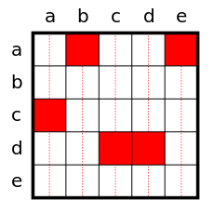
Assume there are five people in our universe, a, b, c, d, and e
We can say…
Everyone is loved by someone
∀x ∃y loves(y,x)
be loved (x)
a is loved by c
b is loved by a
c is loved by d
d is loved by d // this is legal
e is loved by a
who can love (y)
Note that e does not love anyone

Slide 29
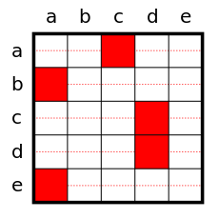
Assume there are five people in our universe, a, b, c, d, and e
We can say…
Everyone loves someone.
∀x ∃y loves(x,y)
be loved (x)
a loves c
b loves a
c loves d
d loves d // this is legal
e loves a
who can love (y)
Note that no one loves e

Slide 30
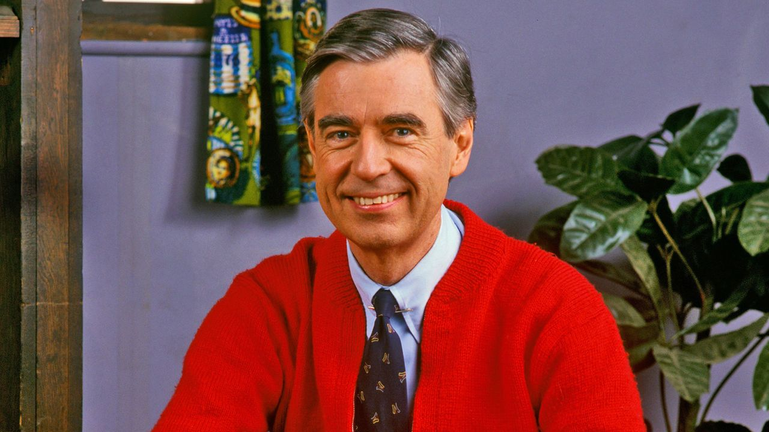
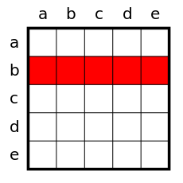
Assume there are five people in our universe, a, b, c, d, and e
We can say…
Someone loves everyone.
∃x ∀y loves(x,y)
be loved (x)
There exists an X (it happens to be b), such that for all people Y (i.e. a,b,c,d,e), it is the case that X loves Y
who can love (y)

Slide 31
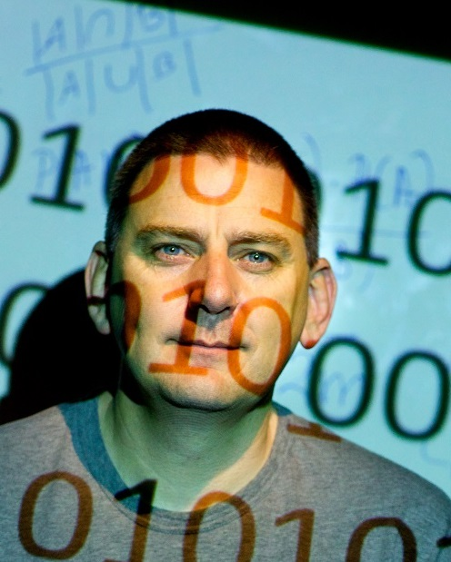
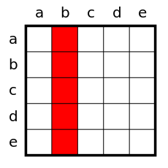
Assume there are five people in our universe, a, b, c, d, and e
We can say…
Someone is loved by everyone.
∃x ∀y loves(y,x)
be loved (x)
There exists an X (it happens to be b), such that for all people Y (i.e. a,b,c,d,e), it is the case that Y loves X
who can love (y)

Slide 32
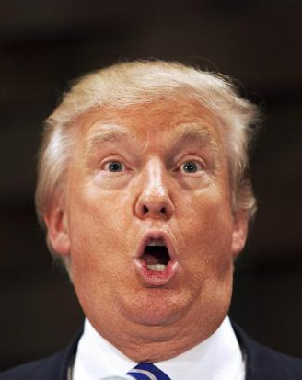
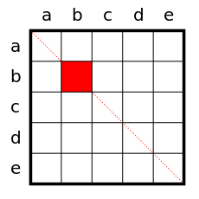
Assume there are five people in our universe, a, b, c, d, and e
We can say…
Someone loves himself.
∃x loves(x,x)
be loved (x)
who can love (y)

Slide 33
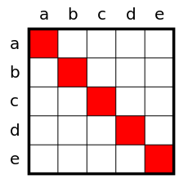
Assume there are five people in our universe, a, b, c, d, and e
We can say…
Everyone loves himself.
∀x loves(x,x)
be loved (x)
who can love (y)

Slide 34
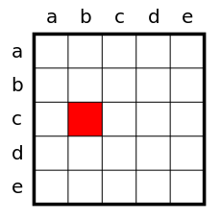
Assume there are five people in our universe, a, b, c, d, and e
We can say…
Someone loves someone.
∃x ∃y loves(x,y)
be loved (x)
who can love (y)

Slide 35
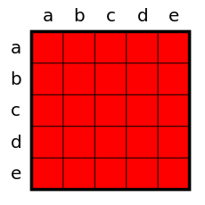
Assume there are five people in our universe, a, b, c, d, and e
We can say…
Everyone loves Everyone.
∀x ∀y loves(x,y)

Slide 36
Some examples of nested qualification
It is always the case that if you are taller than someone, and that person is taller that someone else you must also be taller than that someone else
∀x,y,z isTallerthan(x,y) ∧ isTallerthan(y,z) ⇒ isTallerthan(x,z)
If I want to say that there are an infinite number of numbers, I can say that for every number, there exists another number that is greater by one.
    ∀x ∃y isEquals(x, y - 1)
If I want to say that there is an animal at the top of the food chain, I can say that there exists an animal that eats all other animals.
    ∃x ∀y eats(x,y) Clumsy if written as isEaterof(x,y)
Above I am assuming that only animals exist in my domain. But if my domain includes books, animals and cars, the above states that something exists that eats all of these!
So I should really say
    ∃x ∀y isAnimal(x) ∧ isAnimal(y) ∧ eats(x,y)

Slide 37
Note that the English sentence...
Everybody who loves Eamonn is mentally ill
∀x Loves(x, Eamonn) ⇒ isMentallyIll(x)
Could be rephrased as “There is no one who loves Eamonn that is not also mentally ill”. So we could represent the above as
¬∃x Loves(x, Eamonn) ∧ ¬isMentallyIll(x)
In fact having both ∀ and ∃ is redundant, we could get away with just one of them. However having both makes FOL more readable.

Slide 38
Relationships Between the Qualifiers
These are just generalizations of De Morgan Laws
∀x ¬P ≡ ¬∃x P
¬∀x P ≡ ∃x ¬P
∀x P ≡ ¬∃x ¬P
¬∀x ¬P ≡ ∃x P

Slide 39
At this point we have seen that FOL allows us to represent facts and relationships.
Typically we don’t try to represent all possible facts and relationship in the universe, since that would be a trifle ambitious.
So we concentrate on some particular area of interest, which we call a Domain.
Examples of domains include
The Chess Domain
The Number Theory Domain
The Cancer Domain
The Animal Taxonomy Domain
The Country Domain
The Kinship Domain
In this class we will use the Kinship Domain as a running example...

Slide 40
Predicates for the Kinship Domain
Male, Female Note that I am not using isMale etc
Parent, Sibling, Brother, Sister, Child, Daughter, Son, Spouse, Wife, Husband, Grandparent, Grandchild, Cousin, Aunt, Uncle.
Spouse(Bill, Hilary), Husband(Bill, Hilary), Husband(Hilary, Bill)
Functions for the Kinship Domain
MotherOf, FatherOf
FatherOf(Chelsea), MotherOf(Chelsea)
Note that we have to make choices in defining a domain, for example I am not interested in differentiating between “Grandmother” and “Grandfather”.

Slide 41
Having come up with the Predicates and Functions for our domain, we can now start encoding what facts we know about it...
Ones mother is ones female parent
∀m, c Mother(c) = m ⇔ Female(m) ∧ Parent(m,c)
Everybody is either male or female, but not both
∀x Male(x) ⇔ ¬Female(x)
Everybody has a father
∀x ∃y Father(x) = y
Ones husband is ones male Spouse
∀x,y Husband(x,y) ⇔ Male(x) ∧ Spouse(x,y)

Slide 42
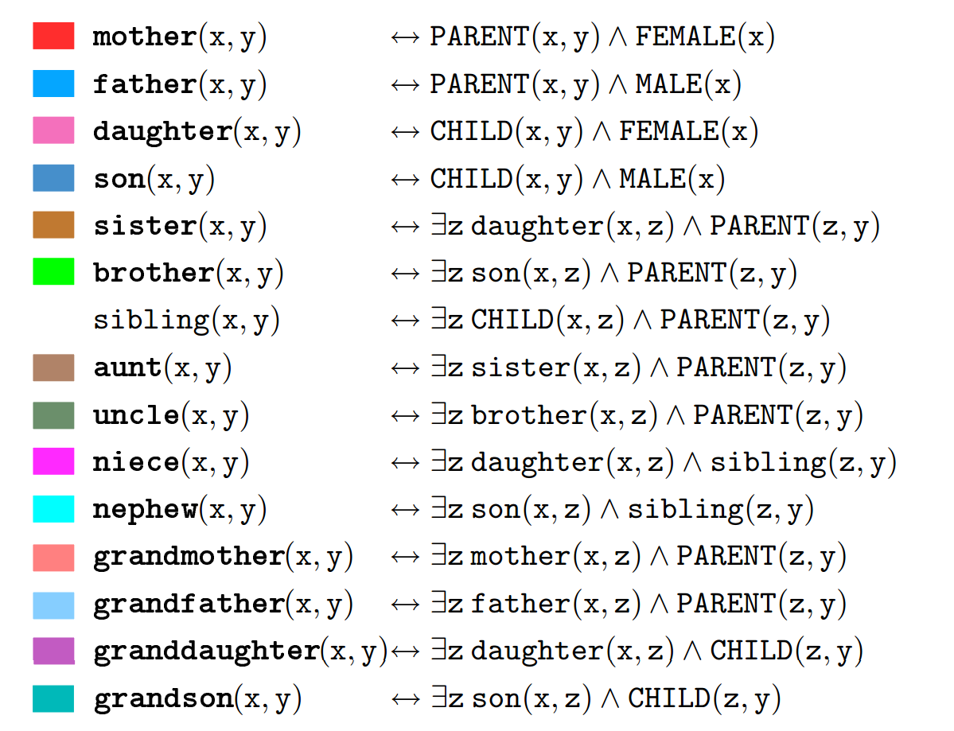
Western

Slide 43
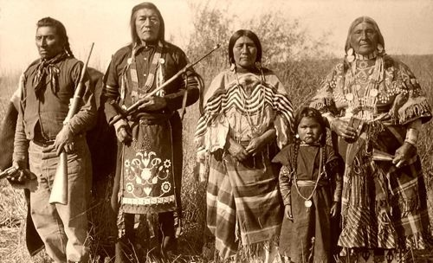
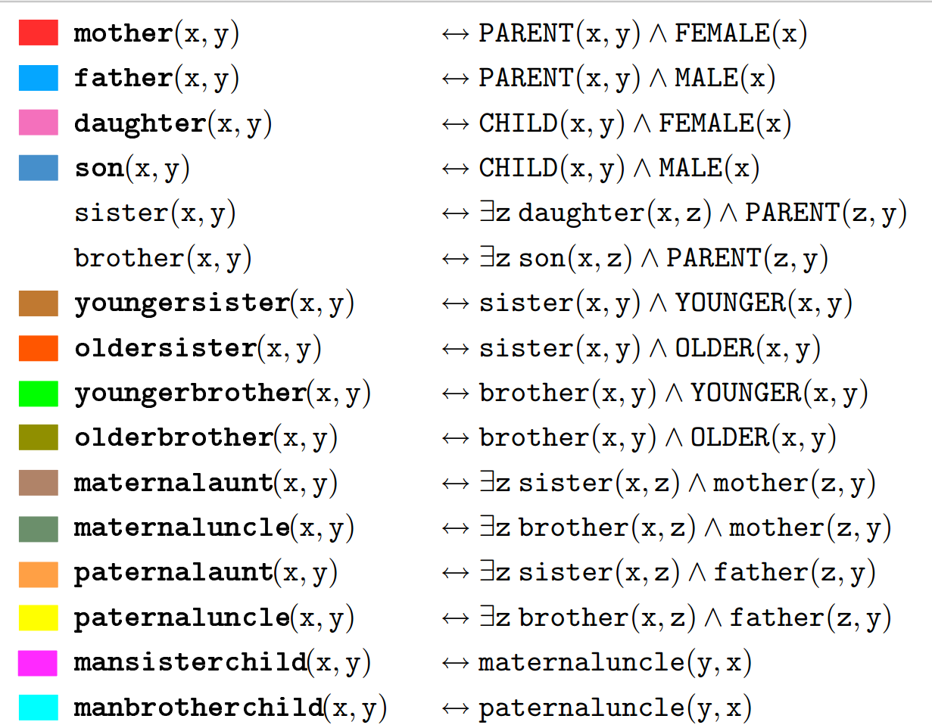
Northern Paiute

Slide 44
Knowledge Base
∀x Male(x) ⇔ ¬Female(x)
¬∃x brother(x , Eamonn) ∧ younger(x, Eamonn)
Male(eamonn)
Female(sue)
(many more omitted)
ASK Male(eamonn) is eamonn male?
ASK Male(sue) is sue male?
ASK ∃x Wife(x , eamonn) is eamonn married?
ASK ∃y Sister(y , sue) does sue have a sister?
ASK ∃x ∃y Married(x,y) is anyone in our universe married?

Slide 45
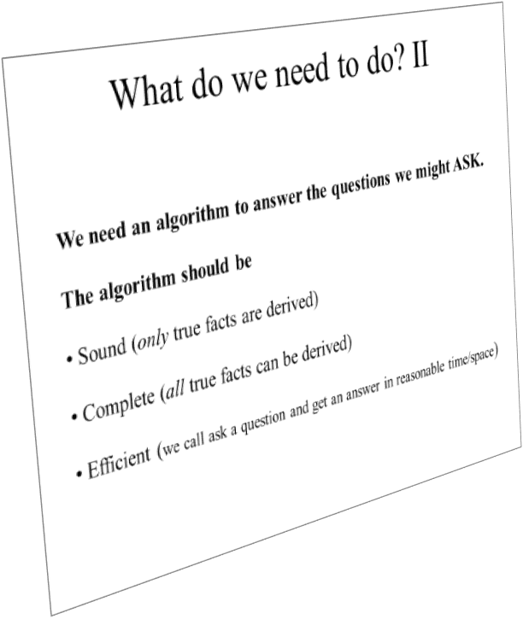
Recall from last time we need an algorithm to answer the queries ASKed
Unfortunately, now that we have the more expressive FOL, we can no longer use truth tables.
So we need a new algorithm..
Next time.

